Slide 1
Deployment of ML models

Slide 2
Content
Why we need to deploy ML model
Deployment of model – Premises vs IaaS vs PaaS vs SaaS cloud platforms
Lifecycle of ml in production
Flask
Hello world with Flask
Forms with Flask
Run ML model on Flask (inference)
Deployment of ML Models in GCP using Flask
Deployment of ML Models in Horeku using Flask
Deployment of ML Models in AWS using Flask
https://www.linkedin.com/in/afsankhan

Slide 3
What does it mean to deploy a Machine Learning Model?
https://www.linkedin.com/in/afsankhan

Slide 4
To understand what it means to deploy an ML model, let’s briefly discuss the lifecycle of an ML project.
https://www.linkedin.com/in/afsankhan

Slide 5
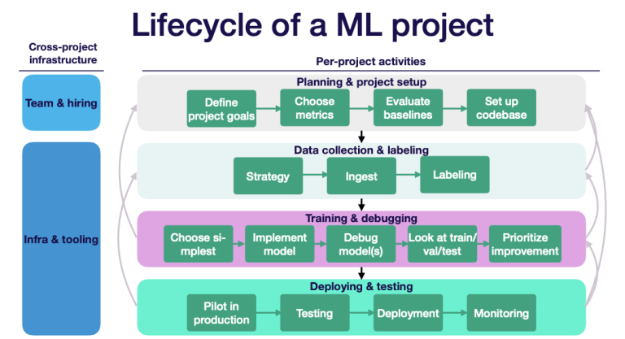
https://www.linkedin.com/in/afsankhan

Slide 6
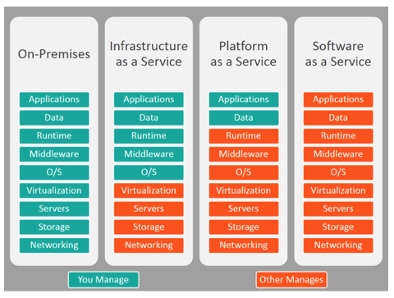
https://www.linkedin.com/in/afsankhan

Slide 7
Examples
IaaS – AWS, Microsoft Azure, Google Compute Engine(GCE)
PaaS – Horeku, Google App Engine
SaaS – Cisco WebEx, Dropbox, GoToMeeting
https://www.linkedin.com/in/afsankhan

Slide 8
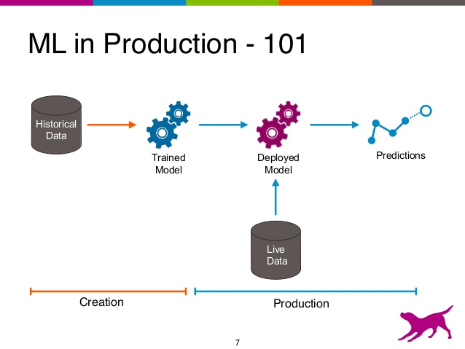
https://www.linkedin.com/in/afsankhan

Slide 9
Saving the models
Pickle
joblib

Slide 10
Flask
Framework for building web applications in Python
https://www.linkedin.com/in/afsankhan

Slide 11
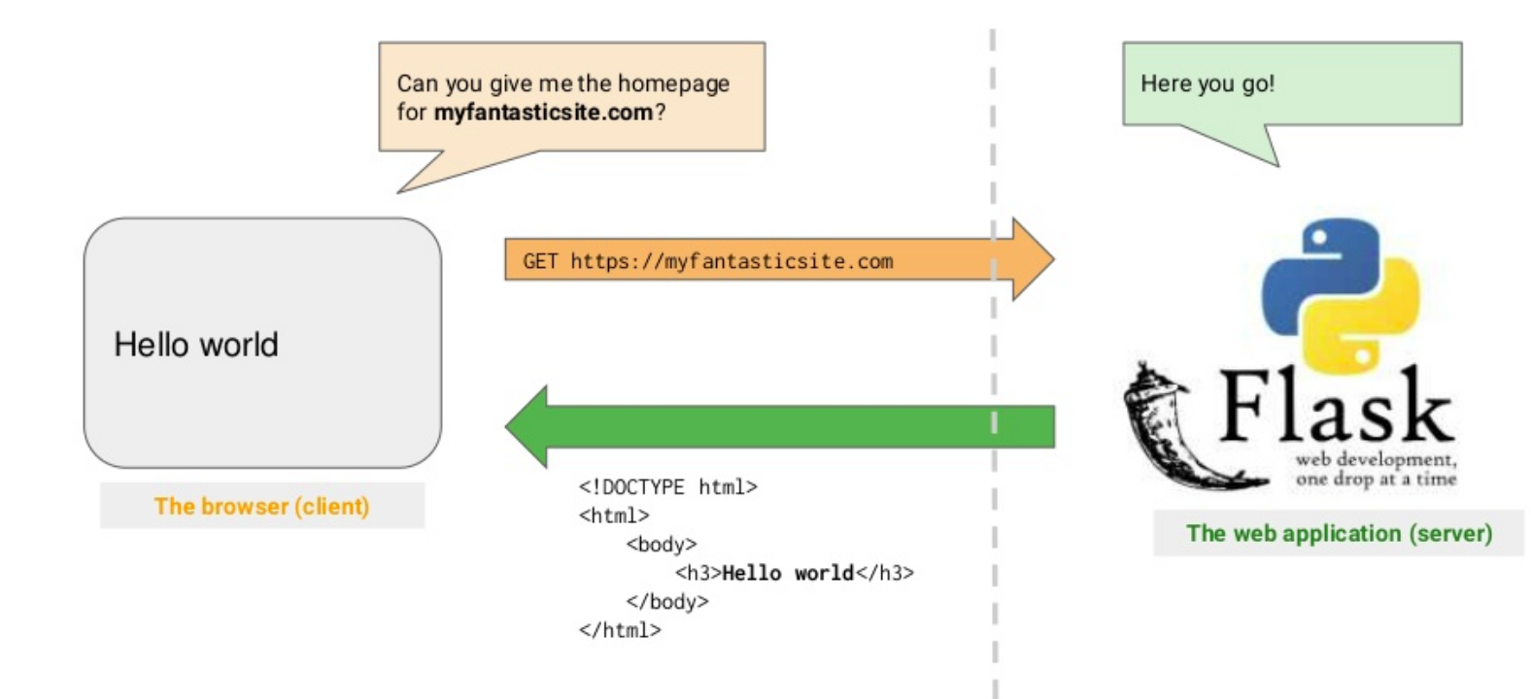
https://www.linkedin.com/in/afsankhan

Slide 12
Before writing a Flask application.....
Install Python
Install virtualenv
- conda create -n <env name> python=3.8
Create a directory for your web application
- mkdir deployement
Activate virtualenv inside your application directory
- conda activate <env_name>
https://www.linkedin.com/in/afsankhan

Slide 13
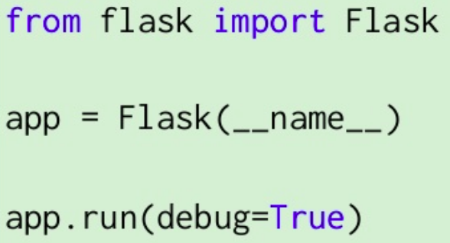
Writing your first Flask application
Activate the env
- conda activate <env_name>
Create a file called main.py in your project directory....
.... and edit it in your favorite text editor
https://www.linkedin.com/in/afsankhan

Slide 14
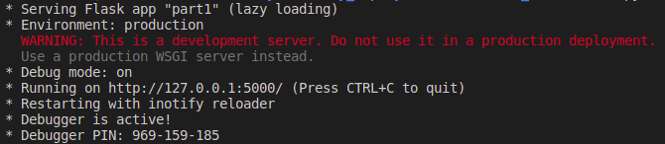
Running your flask application
Run main.py, and visit http://localhost:5000/ in your brower
Note the / after 5000. That’s the route
https://www.linkedin.com/in/afsankhan

Slide 15
Define routes
The web server is running at http://localhost:5000, but you didn’t tell it what to return when someone visits the / route
To do that, you have to add a function for the / route
Flask uses python decorators to define routes
- @app.route(‘/’)
There can be any number of routes in your application
https://www.linkedin.com/in/afsankhan

Slide 16
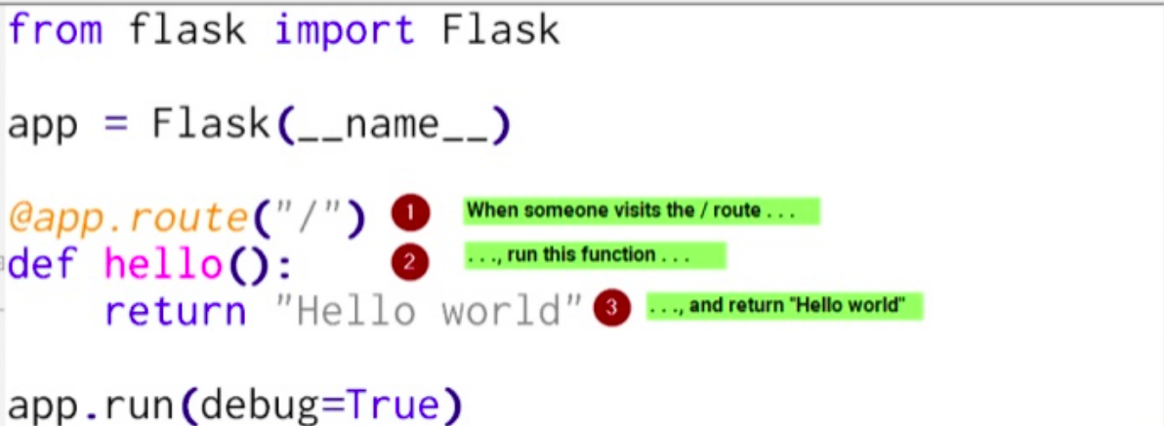
https://www.linkedin.com/in/afsankhan

Slide 17
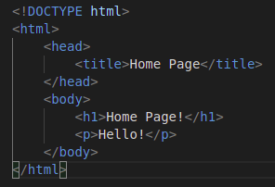
Writing yout first flask application using html template
Activate the env
- conda activate <env_name>
Create a folder called templates and inside templates folder create a file called index.html
https://www.linkedin.com/in/afsankhan

Slide 18
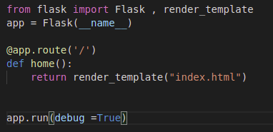
Create a file called main.py and write
https://www.linkedin.com/in/afsankhan

Slide 19
HTTP Request Methods
              What is HTTP?
The Hypertext Transfer Protocol (HTTP) is designed to enable communications between clients and servers.
HTTP works as a request-response protocol between a client and server.
Example: A client (browser) sends an HTTP request to the server; then the server returns a response to the client. The response contains status information about the request and may also contain the requested content.
https://www.linkedin.com/in/afsankhan

Slide 20
HTTP Methods
GET
POST
PUT
DELETE
https://www.linkedin.com/in/afsankhan

Slide 21
GET
GET is used to request data from a specified resource.
POST
POST is used to send data to a server to create a resource.
PUT
PUT is used to send data to a server to update a resource.
Delete
The DELETE method deletes the specified resource.
https://www.linkedin.com/in/afsankhan

Slide 22
Class 4 Content
Deploy regression model in flask
Deploy nlp model in flask
Push all the apps to github
Advantages of using vscode while working with git
Deploy apps on horeku (Paas)
https://www.linkedin.com/in/afsankhan

Slide 23
Heroku
It is the cloud Platform as a Service(PaaS)
You write your app. We do the rest
https://www.linkedin.com/in/afsankhan

Slide 24
Heroku setup
Create Flask app
Install gunicorn using pip install gunicorn
Create requirement.txt file
- pip freeze > requirements.txt
Create Procfile (credentials file)
-
Create account in heroku
Deploy the flask app and run the app
web: gunicorn app:app
https://www.linkedin.com/in/afsankhan

Slide 25
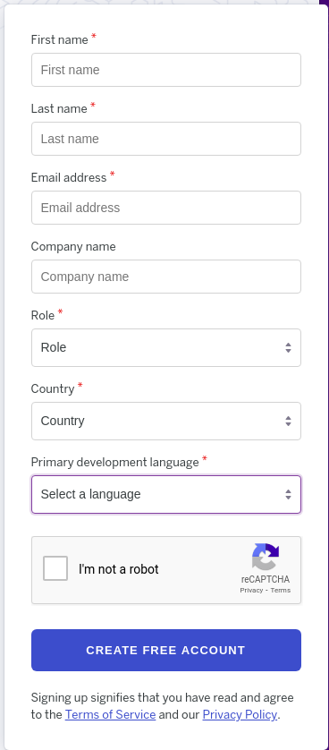
Things to do on horeku server
Create an Account in horeku
https://www.linkedin.com/in/afsankhan

Slide 26
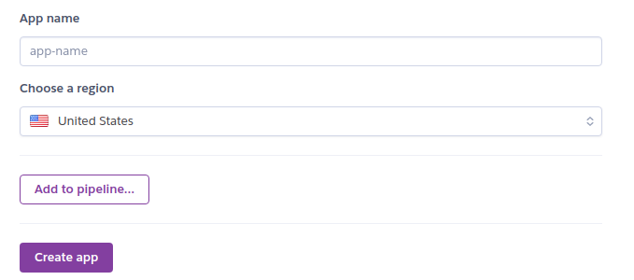
After creating an account, login to that account
Create a new project by clicking on the New button on the homepage and select create new option
Fill the details and click on the button Create app to create app
https://www.linkedin.com/in/afsankhan

Slide 27
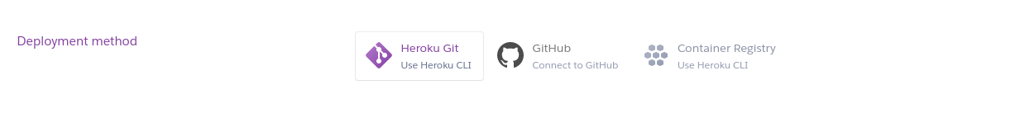
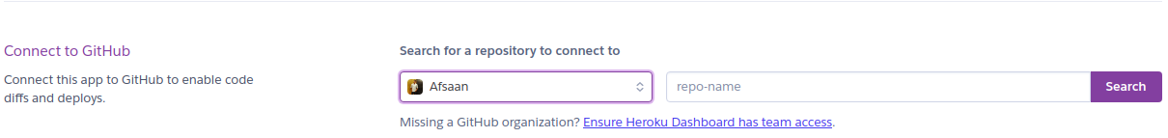
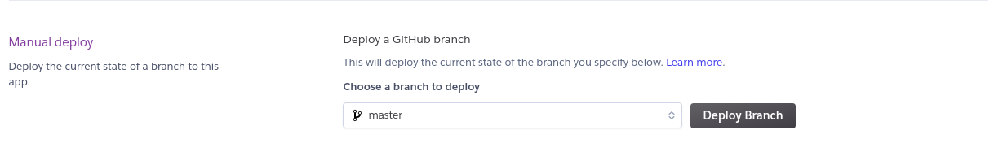
Select the deployement as GitHub
Connect you github account
Select the master branch and press on the Deploy button to deploy the project
https://www.linkedin.com/in/afsankhan

Slide 28
Software Required for Windows User
Putty - https://www.putty.org/ - it helps to connect the aws ubuntu server or any instances that is created
Puttygen - https://www.puttygen.com/ - it helps to create the private key from your .pem file that is downloaded
Winscp - https://winscp.net/eng/download.php - it will help to deploy the code in the aws ec2 instance
https://www.linkedin.com/in/afsankhan

Slide 29
AWS(Amazon Web service)
Aws is a comphrehensive, evolving cloud computing platform provided by Amazon
It provide a mix of IaaS, PaaS and SaaS
Offers a broad set of global compute, storage, databse, analytics, application, and deployment services.
https://www.linkedin.com/in/afsankhan

Slide 30
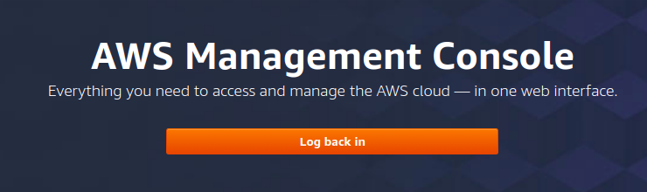
Setup
Create an AWS Account
Login in back to AWS Management Console
https://www.linkedin.com/in/afsankhan

Slide 31
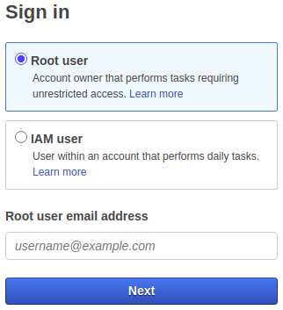
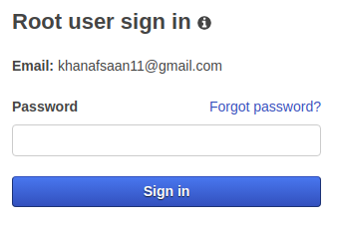
Select the Root user option and provide root user email address and press the next button and enter the password
https://www.linkedin.com/in/afsankhan

Slide 32
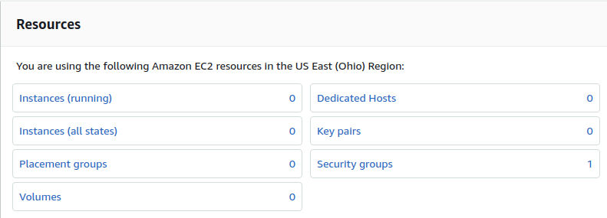
Got to services --> EC2 --> under Resources select Instances
https://www.linkedin.com/in/afsankhan

Slide 33

To create a new instance click Launch instances
https://www.linkedin.com/in/afsankhan

Slide 34
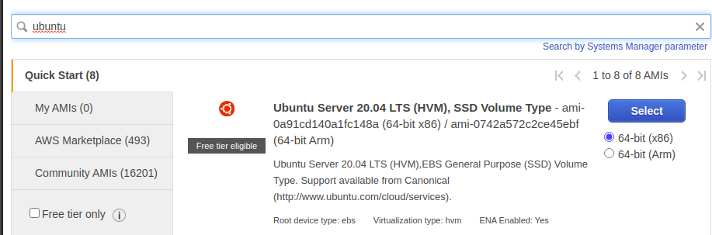
In the search box search for free tier that is available for you like ubuntu
Click on the select button
https://www.linkedin.com/in/afsankhan

Slide 35
Next step is to choose an Instance Type
- select only the instance that is only free tier
Click the Review and Launch button
Click the Launch button
You will get an option to generate a key pair
- in the first text box select the option create a new key pair
- in the second text box enter the name for the key
Click the download button that appears and save the .pem file
https://www.linkedin.com/in/afsankhan

Slide 36
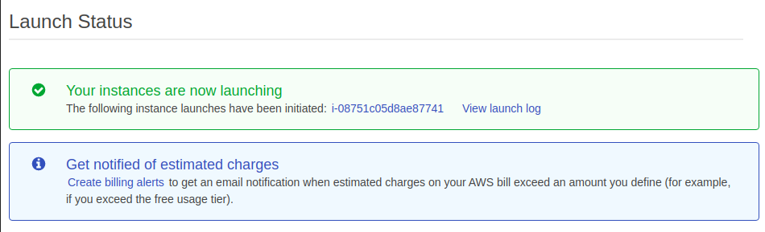
Click the launch button and the below screen will appear
Click on View instnaces to view the instance is is created just now
https://www.linkedin.com/in/afsankhan

Slide 37
Software Required for Windows User
Putty - https://www.putty.org/ - it helps to connect the aws ubuntu server or any instances that is created
Puttygen - https://www.puttygen.com/ - it helps to create the private key from your .pem file that is downloaded
Winscp - https://winscp.net/eng/download.php - it will help to deploy the code in the aws ec2 instance
https://www.linkedin.com/in/afsankhan

Slide 38
Setup windows with AWS
Select the puttygen and open the software
Select the key tab from the menu
Select Parameters for saving key files option
Select PPK file version: 2 instead of 3
Select the load button and upload the .pem file
After loading the .pem file, click the save private key button and select the location to save the private key
Open the winscp software and fill the following details:-
host name , User name
https://www.linkedin.com/in/afsankhan

Slide 39

Click on the action and select the connect
Copy the host name and paste in the winscp hostname
Write the Username as Ubuntu
Click on the advanced button and select the section Ssh and under ssh select authentication
In the private key section upload the private that was generated using puttygen
select ok and the click on the login button
Now you can send any file from the your local computer to aws ec2 instance
https://www.linkedin.com/in/afsankhan

Slide 40
Open the putty software
Enter the hostname
Select the auth sub-section under ssh
Upload the private key that was generated using putty gen
And then click on open and the putty terminal will get open
Now we can perform all the task in the aws ec2 instance using putty CLI
In the putty cli write ubuntu after login as :
https://www.linkedin.com/in/afsankhan

Slide 41
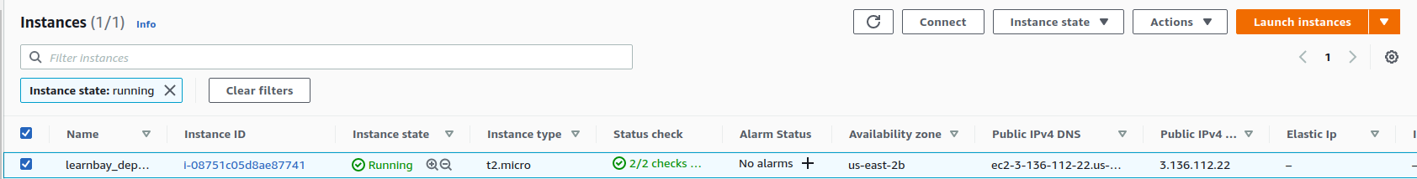
Setup linux with AWS
Click on the Actions and select the connect option
Select the ssh tab and follow the instructions
In the termial type whoami to check the if you are connected or not to ec2 instance
To send file from laptop to ec2 instance write the below command
- sftp -i "aws_deployment.pem" ubuntu@ec2-3-136-112-22.us-east-2.compute.amazonaws.com
https://www.linkedin.com/in/afsankhan

Slide 42
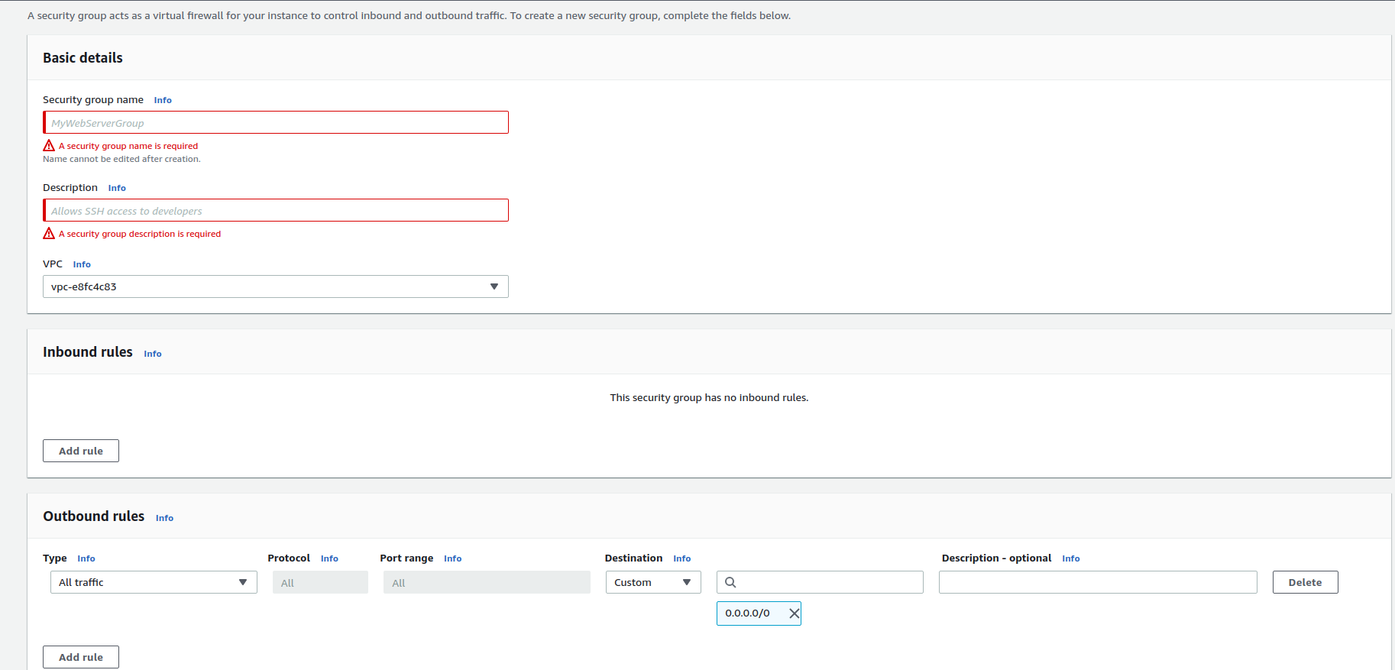
Giving full access to ec2 instance from everywhere
Go to ec2 instance and select the security Groups under Network and security
We have to create the security group so click the button create security group and fill all the details
https://www.linkedin.com/in/afsankhan

Slide 43
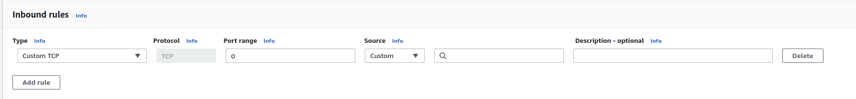
Give the security group name of your choice
Give the description
Click on Add rules button to add the rule
Fill the dropdowns appears when you click the add rule button
type – all traffic
protocol – All
port Range – All
source – Anywhere
Click on the button create security group
The security group will be created
https://www.linkedin.com/in/afsankhan

Slide 44
Link security group with the ec2 instance
Click on network interfaces under the section Network and Security
You can see the ec2 instance that is created
Under the column security groups change the default launch-wizard-1 to your security group
Right click on the launch-wizard-1 and select the option change the security group
Select the security group that you created and click the save button
https://www.linkedin.com/in/afsankhan

Slide 45
Things done till Now
1. Flask code
2. Run and check in local
3. Create AWS account
4. Create EC2 instance
5. Downlaod putty and puttygen (for windows only)
6. Generate private key with puttygen(for windows)
7. setup winscp, putty (for windows)
8. connect ev2 instance with linux/ubuntu
https://www.linkedin.com/in/afsankhan

Slide 46
Installing libraries and packages in ec2
Update the ubuntu and install pip for python3
- sudo apt-get update && sudo apt-get install python3-pip
- sudo apt-get install unzip
- sudo apt-get install nano
Send the flask apllication to the server
windows user – send the files using winscp
linux user – first zip the file and send the files using sftp command
Install all the packages in the requirement.txt file
- pip install -r requirement.txt
Make sure that in app.py the host and port are mentioned
host = ‘0.0.0.0’
port = 8080
https://www.linkedin.com/in/afsankhan

Slide 47
Running the flask code on ec2 instance
Run the flask code using
- python3 app.py
Go to the instance and select the tab connect
You will see the host name like this
Copy the hostname and paste in the url and write the port 8080
http://ec2-3-136-112-22.us-east-2.compute.amazonaws.com:8080/
https://www.linkedin.com/in/afsankhan

Slide 48
Thank you
- Afsan khan get connected email – khanafsaan11@gamil.com linkedin - https://www.linkedin.com/in/afsankhan/

